Slide 1

Project Title -
[Student Name :AGIRI RAJESH
College Name-AVN INSTITUTE OF ENGINEERING AND TECHNOLOGY ]
AICTE STU ID : (STU6a662673b3c431785079411)

Slide 2

PROBLEM STATEMENT
(Agricultural activities are influenced by seasonal variations in environmental conditions, farming practices, resource availability and market conditions. As a result, agricultural performance may differ from one season to another. However, raw agricultural data does not clearly explain how agricultural performance changes across seasons or what patterns can be observed in different seasonal conditions. The problem is to analyze the given agricultural dataset and investigate seasonal differences in agricultural performance by identifying meaningful patterns, trends, relationships and variations within the available data.

Slide 3
Project Description : Seasonal Agriculture Performance Analysis is a data analysis project that examines agricultural activities across different seasons, crops, and geographical areas. The project uses agricultural, environmental, resource-usage, and economic data to identify patterns and differences in seasonal performance. The analysis focuses on yield, production, revenue, cost, and profit, along with factors such as rainfall, temperature, soil moisture, water usage, fertilizer, and pesticide usage. Data cleaning, exploratory data analysis, statistical summaries, and correlation analysis are used to generate meaningful insights and support data-driven agricultural planning and decision-making.

Slide 4

WHO ARE THE END USERS?
The key end users of this project are farmers, agricultural planners, researchers, government agriculture departments, and agribusinesses who can use seasonal agricultural insights for better planning and decision-making.

Slide 5

Technology Used
Python
Pandas
NumPy
Matplotlib
Seaborn
Google Colab

Slide 6
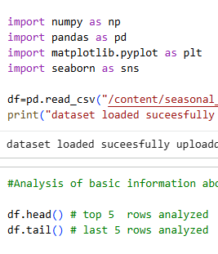
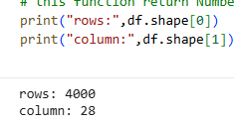
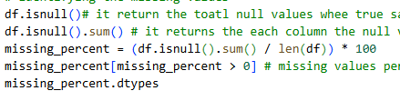
RESULTS
Data Cleaning and Data preprocessing :
DATASET OVERVIEW : DATSET NAME :SEASONAL AGRICULTURAL ANALYSIS.
NO OF RECORDS:4000
NO OF FEATURES :28
MAIN ANALYSIS :SEASONAL PERFORMANCE

Slide 7
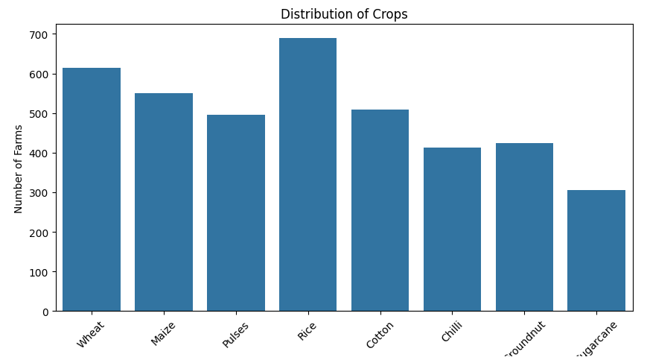
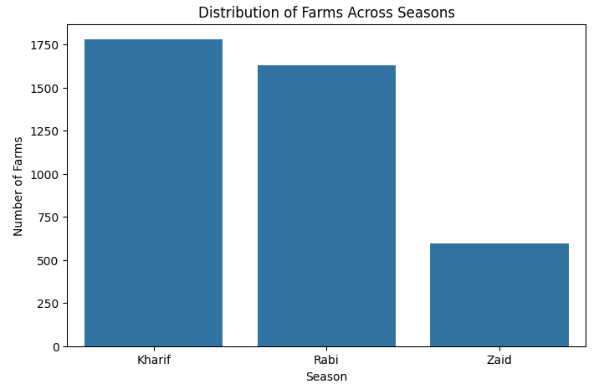
RESULTS EXPLORATOROY DATA ANALYSIS

Slide 8
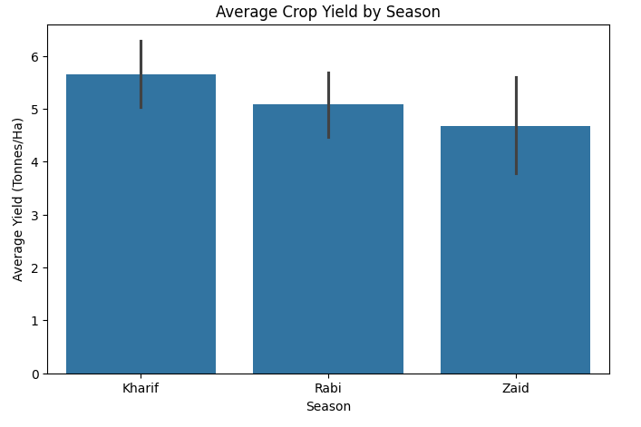
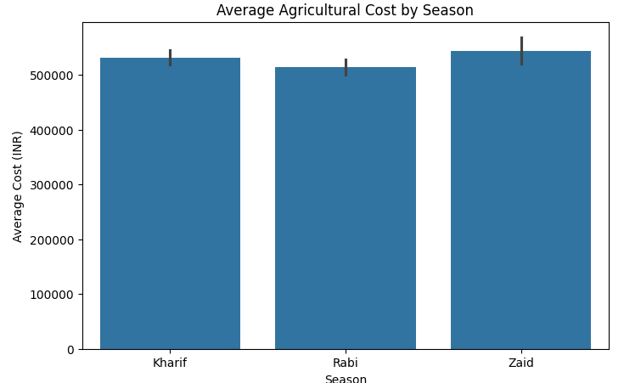
RESULTS
SEASONAL PERFORMANCE:

Slide 9
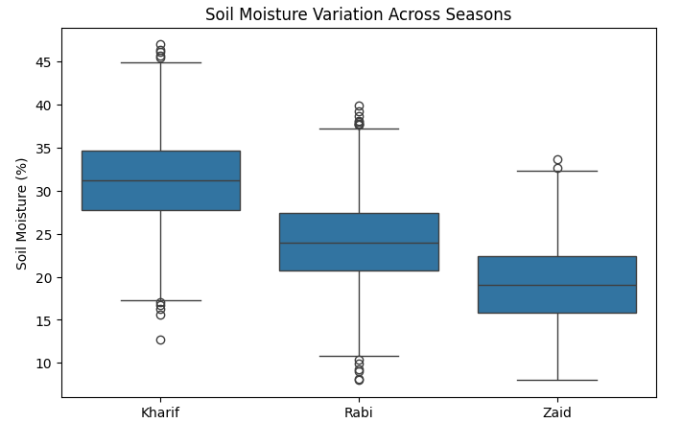
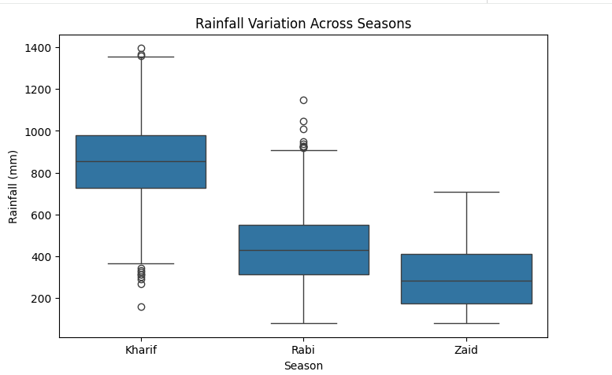
RESULTS
ENVIRONMENTAL ANALYSIS :

Slide 10
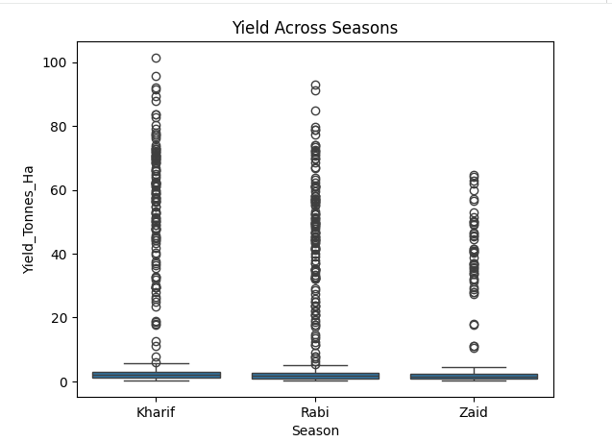
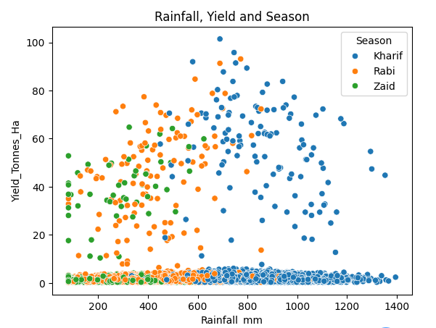
RESULTS RESOURE USAGE:

Slide 11
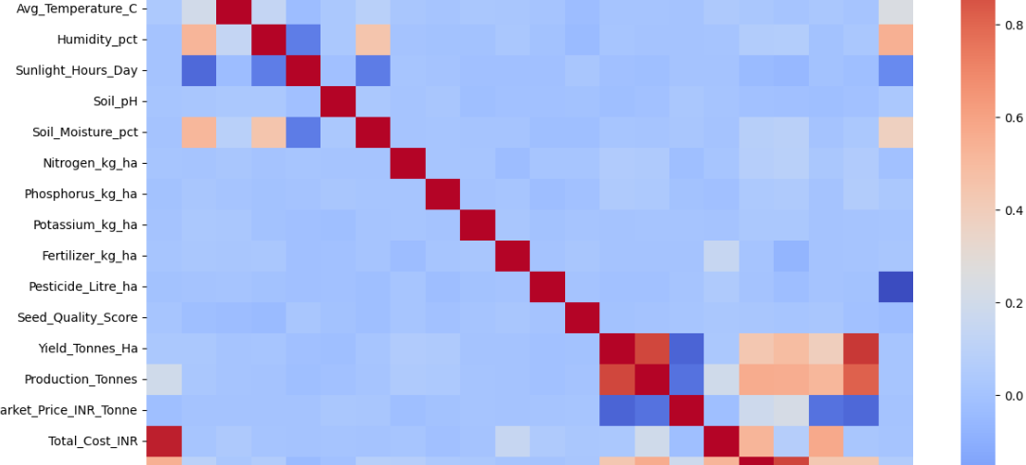
RESULTS
CORRELATION :

Slide 12
Future scope Real-time Data Integration – Include live weather, market price, and agricultural data. Crop Recommendation – Recommend suitable crops based on seasonal and environmental conditions. Predictive Analysis – Predict future crop yield and profitability using Machine Learning. Advanced Environmental Analysis – Study the impact of rainfall, temperature, and soil conditions in greater detail.

Slide 13
GitHub Link CLICK HERE TO VIEW PROJECT https://github.com/rajeshagiri012-cpu/Seasonal-Agriculture-Performance-Analysis.git

Slide 14
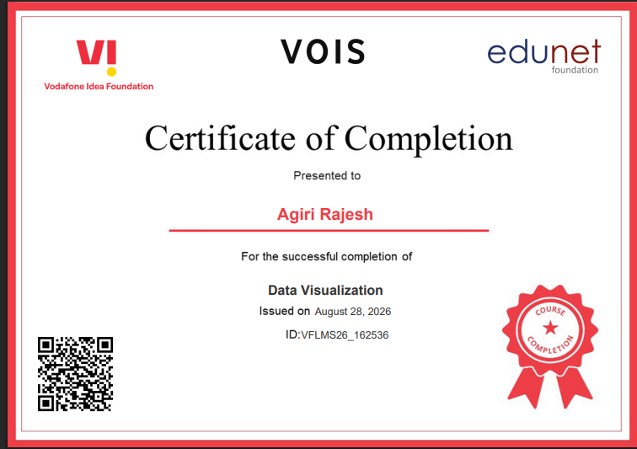
VOIS Course completion certificate - Course name- Data Visualization

Slide 15
Thank you
.
.

